Slide 1
An introduction to Writing Transport SDN Applications (Hands-on)
Ricard Vilalta (CTTC/CERCA), Karthik Sethuraman (NEC Corporation)
OFC 2017 - SC449

Slide 2
Short course Materials
VirtualBox VM image:
http://tiny.cc/ofc-tapi-sc
Github repository:
https://github.com/rvilalta/OFC_TAPI_SC

Slide 3
Outline
13:30 – 13:35 : Welcome, agenda and motivation
13:35 – 14:15 : TAPI Concepts
Context, Topology, Connectivity, etc
14:15 - 15:00 : TAPI SDK & Tooling Overview
UML, YANG, SWAGGER, RI, Extensions/Specification
15:00 - 16:00 : Hands-on : Using TAPI
Modelling: Create simple vendor-specific extensions in UML
Tooling: Generate YANG & SWAGGER modules from UML
Coding: Write logic & execute RI - Server & Client application in Python
16:00 - 16:30 : Coffee break
16:30 - 17:30 : Hands-On : Using ODL/ONOS with TAPI
Introduction to ODL/ONOS northbound REST API, and how it might be used to establish T-API connectivity services

Slide 4
Transport SDN - Motivation

Slide 5










What we see in the market ?
A New Kind of Business Customer
A New Kind of Service Provider
A New Network is Required
A New Kind of Business Customer
Private and public cloud
Elastic compute and storage
Elastic
Compute & Storage
Requires an Elastic Network
Bandwidth-on-demand to match the compute/storage on-demand technology
Multi-tenant
Higher utilization, greater efficiency
Scalable and resilient
Faster service deployment
Hypergrowth - Mobile, Video, Cloud…
A New Kind
of Consumer
Living in the cloud
Streaming Downloads
Driving new network loads
SaaS, IaaS, PaaS
Elastic compute & storage
Multi-tenant

Slide 6
Why is SDN different from traditional SDN Architectures?
Traditional
Architecture
The difference is NOT:
Standardized Management Interfaces
Standardized Architecture
Partly not the Open Interfaces
Partly not even the use cases
SDN Architecture
OSS/BSS System
Apps/ Orch
The difference is:
A new way of thinking
Application focused
Application takes control over the service
Open Source based development
Simplification through Abstraction & Virtualization
NMS/ EMS
SDN Controller
NE
NE
NE
NE
NE
NE

Slide 7
Why do we need SDN in Transport?
Principles of SDN
What it Enables in Transport Network
Programmability:
Programmable interfaces
Applications focused architecture
Abstraction & Virtualization
Multi-Tenant capabilities
Innovation:
Opens doors for new service models
Service differentiation through new application
Simplified Architectures:
Integrated E2E / Multi-layer service creation
Automatic reaction on errors or any changes
Openness:
Open Stanadsrds & Interfaces
Open Source SW
Financial Benefits:
Opex: efficient service setup
Capex: fast ROI / hardware utilization
New revenue opportunities
Integration focused:
Multi-layer
Multi-vendor

Slide 8
Keys to success

Slide 9
2014 OIF-ONF Transport SDN Interop Demo

Slide 10






2016 OIF-ONF Transport SDN Interop Demo Telefónica Lab
Provisioning app
MD Controller/Orchestrator
MD Controller/Orchestrator
Optical Controller
Optical Controller
Optical Controller
Optical Controller
Optical Controller
Traffgen
Traffgen

Slide 11
ONF Transport API (TAPI) Overview

Slide 12




Transport API: Simple Problem Statement….
APP
Network Orchestrator
Open
Standard
T-API
ONOS APIs
ODL APIs
Proprietary APIs
ONOS
ODL
Proprietary/ Legacy Systems

Slide 13
Transport API Project Overview
Objective – realize a software-centric approach to standardization
Purpose-specific API to facilitate SDN control of Transport networks
Focus is on functional aspects of transport network control/mgmt
Target is YANG & JSON API libraries
Demonstrable code
Activity scoped based on use case contributions and discussions. Examples include
Bandwidth on Demand
E2E Connectivity Service
Multi-layer Resource Optimization and Restoration
Multi-Domain Topology and Monitoring
Network Slicing and Virtualization
Topology Service
Retrieve Topology, Node, Link & Edge-Point details (Across al layers)
Connectivity Service
Retrieve & Request P2P, P2MP, MP2MP connectivity (Across all layers)
Path Computation Service
Request for Computation & Optimization of paths
Virtual network Service
Create, Update, Delete Virtual Network topologies
Notification Framework
Subscription and filtering
Autonomous mechanism
TAPI 2.0
Protection, OAM, Alarm & TCAs
Node Connectivity Constraints

Slide 14
ONF Transport – API & Interfaces: Functional Architecture
Application
SDN Controller
NE
NE
NE
NE
Transport API
Topology Service
Connectivity Service
Path Computation Service
Virtual Network Service
Notification Service
Shared Network Information Context
SBIs (e.g. TL1, Openflow Optical, etc)
Transport API
Network Resource Groups
SDN Controller
NE
NE
NE

Slide 15
TAPI Concepts Overview
All TAPI interaction between an API provider (e.g. SDN Controller) and an API Client (e.g. Application, Orchestrator or SDN Controller) occur within a shared “Context”
TAPI Context is defined by a set of ServiceEndPoints (and some policy)
ServiceEndPoints enable requesting of TAPI Services (e.g. ConnectivityService) between them.
With reference to ConnectivityServices, a ServiceEndPoint conceptually represents a pool of “potential” ConnectionEndPoints.
A TAPI provider may expose one or more abstract Topology within the shared Context
These topologies may or may-not map 1-to-1 to a provider’s internal topology.
A Topology is expressed in terms of Nodes and Links between them.
Links terminate on NodeEdgePoints, Nodes aggregate NodeEdgePoint
NodeEdgePoint and ConnectionEndPoints have a server-client/mux-demux, etc relationship in terms of data-plane signal hierarchy
TAPI provider creates(provisions) one or more Connections in response to a successful ConnectivityService request between a set of 2 or more ServiceEndPoints
ConnectionEndPoints encapsulate information related to a Connection at the ingress/egress points of every Node that the Connection traverses in a Topology
Knowledge of Topology is needed to understand the Route of a Connection
Route of a Connection is described as a list (series) of lower-level Connections

Slide 16
TAPI Interface Overview
TAPI SDK 1.0 is an initial release that targets interfaces to key Transport SDN controller functions
Topology Service
Retrieve Topology, Node, Link & Edge-Point details – (L0-L2) layers
Connectivity Service
Retrieve & Request P2P, P2MP, MP2MP connectivity - (L0-L2) layers
Path Computation Service
Request for Computation & Optimization of paths
Virtual Network Service
Create, Update, Delete Virtual Network topologies
Notification Framework
Subscription and filtering
Autonomous mechanism

Slide 17
T-API Shared Context
Shared Context – entire context for the T-API Provider & Client interaction
Context for Topology, Connectivity, Path Computation, Virtual Network and Notification Service APIs
Defined by set of Service-End-Points
Includes one or more top-level Topologies within the shared context that are
Either statically assigned by the Provider
Or dynamically created by the Client using Virtual Network Service API
Defined by a set of Nodes and Links
A Node aggregates Node-Edge-Points, Link terminates on Node-Edge-Points
A Node can encompass an internal Topology and be recursively decomposed into its lower-level Nodes and Links
Provides scope for control (create/update/delete) of Connections (and its Connection-End-Points) using Connectivity Service APIs
Utilizes one or more shared namespace
Setup & requirements of shared context depends on offline negotiation/agreement between TAPI provider & its client
Determines type and degree of abstraction that is provided
Must not be confused with API provider’s or client’s internal context

Slide 18
Topology Service (Retrieval APIs only)
Get Topology Details
Returns attributes of the Topology identified by the provided input Id .
This includes references to lower-level Nodes & Links encompassed by the Topology
Get Node Details
Returns attributes of the Node identified by the provided input Id .
This includes references to Node-Edge-Points aggregated by the Node
This also includes attributes representing the identification, naming, states and forwarding capabilities of the Node.
Get Link Details
Returns attributes of the Link identified by the provided input Id.
This includes references to Node-Edge-Points terminating the Link.
This includes references to the Nodes associated by the Link.
Get Node-Edge-Point Details
Returns attributes of the Node-Edge-Point identified by the provided input Id.
This currently does NOT include reference to mapped/contained Service-End-Points or Connection-End-Points
TAPI Service-End-Point/Connection-End-Point instead have references to the associated Node-Edge-Point
All of the APIs support a retrieve-scope Filter: Layer-Protocol List
If set, API call will return output that is relevant to the specified Layer only

Slide 19
Connectivity Service (Retrieval API)
Get Connectivity Service-End-Point List
Returns list of ServiceEndPoints that can be used or being used in a connectivity Service request
This also includes the attribute details for each ServiceEndPoint
Get Connectivity Service-End-Point Details
Returns attributes of the ServiceEndPoint identified by the provided input Id.
Get Connectivity-Service List
Returns list of Service entities that represent the connectivity requests that were received
This also includes attribute details for each Service including
Includes references to ServiceEndPoints terminating the Service
Optionally includes references to any Connections realizing the Service
Get Connectivity-Service Details
Returns attributes of the Service entity identified by the provided input Id, that represents a received connectivity request.
This includes references to ServiceEndPoints terminating the Service.
This optionally includes references to any Connections realizing the Service.
Get Connection Details
Returns attributes of the Connection entity identified by the provided input Id.
This includes references to ConnectionEndPoints terminating the Connection.
This includes references to Paths in the underlying Topology.
This includes reference to the Node containing this Connection.
Get Connection-End-Point Details
Returns attributes of ConnectionEndPoint identified by the provided input Id.
This includes reference to the NodeEdgePoint containing this ConnectionEndPoint.

Slide 20
Connectivity Service (Request)
Related to creation of forwarding entities
Intent-like – option allows the TAPI Provider to compute path and realize the service request
Current focus is point-to-point
Many initial uses, e.g., BoD, DC Interconnect
Prototyped in 2014 Demonstration
APIs flexible to support other types (p2mp, mp2mp) - Use case analysis planned in near future
Create Connectivity Service
Service Endpoint List – each Endpoint is described by
Name (TRI/URI/Proprietary string)
TRI formats for ODU, ETH, MPLS-TP to be specified by the IA (implementation)
Role (Symmetric, Root, Leaf) and Directionality (Input, Output, Bidirectional)
Layer of the ServiceEndPoint if it supports multiple layers
Connectivity Requirements
Service Type (P2P, P2MP, MP) - required
Capacity/Bandwidth – fixed or a range – required
Service Layer (ETH, MPLS-TP, ODU, OCH)
Service Level - a abstract value the meaning of which is mutually agreed – typically represents metrics such as - Class of service, priority, resiliency, availability
Latency - integer value and unit - upper bound
Cost - Vector of one or more metrics that would enable the provider to make a decision when implementing the Service
Coroute-Inclusion or Diversity Exclusion - an include/exclude Service ID(s) –indicates that the requested service should be co-routed or diverse (not share resources) from specified service
Include Path – indicates partial set of nodes and links to be used
Exclude Path - indicates partial set of nodes and links to be avoided
Start Time & End Time
Output: Service ID and the created Connection

Slide 21
Path Computation Service (Request)
Compute P2P Path
The API client can request the API provider to compute a single path or a batch of paths with provided set of constraints
The API provider should have topology information (including TE information) of the network in which the path computation is applied
Inputs
Service Endpoint List – same endpoints as the Connectivity API
Routing (Connectivity) Constraints including
Required Constraints such as Capacity
Optional Constraints such as Layer, Latency, Cost, etc
Objective function
Output
A list of Path options each of which is an ordered list of TE Links – either as strict hops (NodeEdgePoints) or loose hops (Nodes)
Optimize P2P Path
Modify an existing path to optimize as per the objective function
In addition to above, is provided Optimization Constraints as input

Slide 22
Virtual Network Service (Request)
APIs to allow an API-Client to request creation, deletion, update of virtual network (client created) Topologies with its shared context
Create Virtual Network (VN) Topology
Inputs
Service Endpoint List – same endpoints as the Connectivity API
Topology Constraints including
Traffic matrix: A matrix to describe the traffic (e.g. bandwidth) between each pair of the client’s access points
Optional Constraints such as Layer, Latency, Cost, etc
Start Time & End Time
Output
Topology ID of the topology that has been created
The VN Topology can be retrieved using Topology Service API and is no different than the static Provider created topology
API Client would use the Connectivity Service APIs to create Connections on-demand over the VN Topology

Slide 23
TAPI Resource : Topology Constructs
(API) Context – defines the scope of control and naming that a particular T-API provider or its client application has with respect to the information exchanged over the interface.
This Context is shared between the API provider and its client and determines the makeup of the network resource abstractions over which the API operates.
Topology – representation of the transparent topological-aspects of a Forwarding-Domain (FD)
Topology describes the underlying topological network of Nodes and Links that enable the forwarding function provided by the FD.
Node – representation of the opaque forwarding-aspects of the Forwarding-Domain (FD)
Node describes the edge ports of the FD (Node-Edge-Point) and the forwarding capabilities between those edge ports.
Link – representation of the effective adjacency between two or more associated Nodes in a Topology.
Link is terminated by Node-Edge-Points of the associated Nodes. The Node-Edge-Points have a specific role with respect to the Link

Slide 24
TAPI Resource: End-Point/Termination Constructs
Node-Edge-Point - represents the node-facing aspect of the edge-port functions for accessing the forwarding capabilities provided by the Node.
Node-Edge-Point provides an encapsulation of addressing, mapping, termination, adaptation and OAM functions of one or more transport layers (including circuit and packet forms) performed at the entry/exit points of Node.
Service-End-Point - represents the outward-facing aspect of the edge-port functions for accessing the forwarding capabilities provided by Node.
Service-End-Point provides a limited, simplified view of interest to external clients (e.g. client addressing, capacity, resource availability, etc), that enable the clients to make a connectivity service request without the need to understand the provider network internals.
Service-End-Point have a mapping relationship (one-to-one, one-to-many, many-to-many) to Node-Edge-Points
Connection-End-Point - represents the ingress/egress port functions for accessing to the forwarding function provided by the Connection.
Connection-End-Point have client-server relationship with Node-Edge-Points

Slide 25
TAPI Resource : Forwarding Constructs
Connectivity Service - represents an “intent-like” request for connectivity between two or more Service-End-Points.
Service is a container for connectivity request details and is distinct from Connection that realizes the request
They refer to different aspects of information exchanged over T-API interface, but within provider they could be modeled by the same instance if there is one-to-one mapping.
Connection - represents an enabled (provisioned) potential for forwarding (including all circuit and packet forms) between two or more Node-Edge-Points of a Node.
Connection is a container for provisioned connectivity that tracks the state of the allocated resources and is distinct from the connectivity Service request.
Path - represents the route of a Connection through the lower-level Nodes in the underlying Topology
Path is described as a list of references to the lower-level Connections.

Slide 26
TAPI Concepts & Example

Slide 27
Simple Physical Network Example to illustrate T-API
CE – Customer Edge
PE – Provider Edge
P - Provider
CE2
CE5
Node Edge Point (Network Edge)
Node Edge Point (Network Internal)
Service EndPoint
UNI
PE2
CE1
CE3
PE1
PE3
CE4
CE6
UNI
P
UNI
A Network Provider (Blue) with two Customers (Red and Green)
All UNI interfaces are ETH (e.g. 10GE), I-NNI interfaces are OTU (e.g. 100G OTN)
All PE-NE are ODU/ETH capable, while P-NE is only ODU capable

Slide 28
T-API Contexts for the Simple Network Example (based on ONF Architecture v1.1)
Application
RED
SDN Controller GREEEN
Admin APP
Blue
Resource Group
Resource Group
Client
TAPI
TAPI
TAPI
Shared Context
RED
Shared Context
GREEN
Shared Context
BLUE.Admin
Resource Group
Resource Group
Resource Group
Server
Provider Internal Context
Provider SDN Controller
Orchestration / Virtualization
Other Admin Interfaces
Client
Server Context
PE1
Server Context
PE2
Server Context
PE3
Server Context
P
Resource Group - PE1
Resource Group - PE2
Resource Group - PE3
Resource Group - P
Server

Slide 29
Example Shared Contexts
Topology
Link
Red Shared Context
R1
Node
Mapping
Node Edge Point (NW Edge)
Node Edge Point (NW Internal)
Service End Point
Blue Internal Context
Green Shared Context
PE2
G2
PE1
PE3
G1
G3
P

Slide 30
Recursive Topology Decomposition within a Shared Context
Topology
Link
Red Shared Context
R1
Node
Mapping
Node Edge Point (NW Edge)
Node Edge Point (NW Internal)
Service End Point
Red Shared Context
R1
R1.2
R1.1
R1.3

Slide 31
Client1 (Red) Shared Context (empty Topology example)
Shared Context defined by the set of ServiceEndPoints
No Topology exposed - Retrieving topology will return empty
ConnectivityService can be requested between ServiceEndPoints
Client provides input ConnectivityConstraints – Capacity/BW is the only required input
Associated Connection representing network resources is created/returned to Client
Node Edge Point (Edge)
Node Edge Point (Internal)
Shared Context
Service End Point
Connection EndPoint
Topology
Node
Connection
Mapping
Connectivity Service
Link
Transitional Link
Connection

Slide 32
Client-1 (Red) Shared Context (Single Node Topology example)
Single Node abstraction example
Node and its NodeEdgePoints provide some approximation of the network capabilities
ConnectivityService can be requested between ServiceEndPoints
Connections appear as cross-connections across node, no visibility of underlying route
Node Edge Point (Edge)
Shared Context
Node Edge Point (Internal)
Service End Point
Connection EndPoint
Topology
Connection
Node
Mapping
Link
Connectivity Service
Transitional Link
ETH
Connection

Slide 33
Client 2 (Green) Shared Context (Multi-Node Topology example)
Multiple Nodes (PEs) Topology example
Node and its NodeEdgePoints provide reasonable information of their capabilities
ConnectivityService can be requested between ServiceEndPoints
Connection route can be traced over the exposed Topology
Node Edge Point (Edge)
Shared Context
Node Edge Point (Internal)
PE2
Service End Point
ETH
Connection EndPoint
Topology
Node
PE1
Connection
PE3
Mapping
Link
Connectivity Service
Transitional Link
Connection

Slide 34
Admin (Blue) Shared Context (example Multi-layer Topology)
Shared Context
PE2
ETH
PE1
PE3
Connection
Connectivity Service
PE2
ODU
PE1
PE3
P
34

Slide 35
Client-1 (Green) Shared Context (Virtual Network Topology example)
Client requests VN Topology between ServiceEndPoints within its Shared Context
Provider creates a Topology based on the input Topology constraints (e.g. traffic matrix)
Single Node or Multiple Node abstraction of Topology
Node and its NodeEdgePoints provide some approximation of the network capabilities
ConnectivityService can be requested between ServiceEndPoints
Node Edge Point (Edge)
Shared Context
Node Edge Point (Internal)
PE2
Service End Point
Connection EndPoint
VN Topology Service
Topology
PE1
PE3
Node
Mapping
Connectivity Service
Link
Transitional Link
ETH
Connection

Slide 36
TAPI Multi-domain Concepts & Example

Slide 37
Multi-Domain Physical Network Example to illustrate T-API
Node Edge Point (Network Edge)
Node Edge Point (Network Internal)
1
Service EndPoint
UNI
Domain-1
Domain-2
Domain-3
UNI
NNI
NNI
D1-4
D3-4
G-1
1
D2-1
D2-3
11
G-2
D1-1
D1-3
5
7
D3-3
D3-1
R-1
2
D1-2
6
D2-2
8
D3-2
12
R-2
UNI
3
4
9
10
UNI
G-3
R-3
R-4
G-4
3 Network domain (Blue) with two Customer domains (Red and Green)
All UNI interfaces are ETH (e.g. 10GE), NNI interfaces are OTU (e.g. 100G OTN)
All UNI boxes are ODU+ETH switch capable, while rest are only ODU switch capable

Slide 38
Reference Multi-domain Hierarchical Control Example
3 Provider domains (Blue)
2 Customer domains (Red and Green)
All UNI interfaces are ETH (e.g. 10GE)
NNI interfaces are OTU (e.g. 100G OTN)
All UNI devices are ODU+ETH switch capable
Internal devicesare only ODU switch capable
Node Edge Point (Network Edge)
Node Edge Point (Network Internal)
1
Service EndPoint
1.G
TAPI Context-G
10.G
2.R
TAPI Context-R
9.R
3.G
11.G
4.R
12.R
Multi-Domain Controller
Abstraction & Orchestration
1.D1
TAPI Context-1
5.D1
5.D2
TAPI Context-2
7.D2
7.D3
TAPI Context-3
11.D3
2.D1
6.D1
6.D2
8.D2
8.D3
12.D3
3.D1
4.D1
Domain-2 Controller
9.D3
10.D3
Domain-1 Controller
Domain-3 Controller
Abstraction & Orchestration
Abstraction & Orchestration
Abstraction & Orchestration
Domain-1
Domain-2
Domain-3
G-1
D1-4
D2-3
D3-4
G-2
1
D1-1
5
D2-1
7
D3-1
11
R-1
D1-3
D3-3
2
D1-2
6
D2-2
8
D3-2
12
R-2
UNI
UNI
3
4
NNI
NNI
9
10
UNI
UNI
G-3
R-3
R-4
G-4

Slide 39
Domain-1 TAPI Context Topology
This slide depicts the complete Topology exposed by domain-controller 1 to the multi-domain-controller*
It is assumed that the exposed TAPI-Context Topology is a 2 Node abstraction (1 per layer) of domain-controller ‘s internal Context
It is assumed that no Connectivity has been setup in the entire domain and this is the initial Topology view
Node Edge Point (Edge)
TAPI Context-1
Physical Box View (internal)
Node Edge Point (Internal)
D1
Domain-1
Service End Point
1.D1
D1-e
UNI
NNI
Connection EndPoint
2.D1
D1-4
Topology
3.D1
G-1
1
D1-1
D1-3
5
Node
4.D1
R-1
6
2
D1-2
Mapping
Link
D1-o
UNI
3
4
Transitional Link
5.D1
G-3
R-3
Connection
6.D1
Connectivity Service
*The multi-domain controller may have to invoke more than one retrieval API operation to get this view

Slide 40
Domain-2 TAPI Context Topology
This slide depicts the complete Topology exposed by domain-controller 2 to the multi-domain-controller*
It is assumed that the exposed TAPI Context Topology is same as the domain-controller’s internal Context
It is assumed that no Connectivity has been setup in the entire domain and this is the initial Topology view
Node Edge Point (Edge)
TAPI Context-2
Physical Box View (internal)
Node Edge Point (Internal)
Service End Point
Connection EndPoint
Domain-2
Topology
NNI
NNI
Node
D2-1
D2-3
Mapping
5
7
D2
6
D2-2
8
Link
D2-1o
D2-3o
Transitional Link
5.D2
7.D2
Connection
6.D2
8.D2
Connectivity Service
D2-2o
*The multi-domain controller may have to invoke more than one retrieval API operation to get this view

Slide 41
Domain-3 TAPI Context Topology
This slide depicts the complete Topology internal to the multi-domain-controller*
It is assumed that the exposed TAPI Context Topology is same as the domain-controller’s internal Context
It is assumed that no Connectivity has been setup in the entire domain and this is the initial Topology view
Node Edge Point (Edge)
TAPI Context-3
Physical Box View (internal)
Node Edge Point (Internal)
11.D3
Service End Point
D3-1e
Connection EndPoint
12.D3
Domain-3
UNI
Topology
D3-2e
9.D3
NNI
D3-4
Node
10.D3
11
G-2
7
D3-3
D3-1
Mapping
D3
D3-2o
8
D3-2
12
R-2
Link
Transitional Link
7.D3
D3-3o
D3-1o
UNI
8.D3
9
10
Connection
D3-4o
R-4
G-4
Connectivity Service
*The multi-domain controller may have to invoke more than one retrieval API operation to get this view

Slide 42
Domain-3 TAPI Context Hierarchical Topology (2-Level)
This slide depicts complete Topology exposed to multi domain-controller as 2-Level hierarchy*
It is assumed that the exposed TAPI Context top-level Topology is an 2 Node abstraction of domain-controller‘s internal Context
This view is constructed by recursively traversing/expanding the internal Topology of top-level Nodes
It is assumed that no Connectivity has been setup in the entire domain and this is the initial Topology view
TAPI Context-3
Node Edge Point (Edge)
Physical Box View (internal)
Node Edge Point (Internal)
D3-1e
11.D3
Service End Point
D3e
12.D3
Connection EndPoint
Domain-3
UNI
Topology
D3e
D3-2e
9.D3
NNI
10.D3
D3-4
Node
11
G-2
7
D3-3
D3-1
Mapping
D3
D3-2o
8
D3-2
12
R-2
Link
Transitional Link
7.D3
D3-3o
D3o
D3-1o
8.D3
9
10
UNI
Connection
D3o
D3-4o
R-4
G-4
Connectivity Service
*The multi-domain controller may have to invoke more than one retrieval API operation to get this view

Slide 43
MD Controller Local Resource Pool (Internal)
This slide depicts the complete Topology internal to the multi-domain-controller in terms of TAPI-like constructs*
This view is not exposed to the applications over TAPI.
The abstraction mapping is maintained internally by the MD domain controller
The MD controller is responsible for matching-up and mapping the service-end-points of different domains
It is assumed that no Connectivity has been setup in the entire domain and this is the initial internal Topology view
D1
MD Controller Internal View (not exposed)
D3
1.G
1.D1
D1-e
D3-1e
11.D3
11.G
2.R
2.D1
12.D3
12.R
3.G
3.D1
D3-2e
10.D3
10.G
4.R
4.D1
9.D3
9.R
D1-o
D2
D3-2o
D2-1o
D2-3o
5.D1
5.D2
7.D2
7.D3
D3-3o
D3-1o
6.D1
6.D2
8.D2
8.D3
D2-2o
D3-4o
* An controller internal model may not be based on TAPI

Slide 44
Green TAPI Context Topology (single-layer, single Node topology example)
This slide depicts the complete Topology exposed by the multi-domain-controller to the Green application
It is assumed that exposed TAPI-Context Topology is a single Node abstraction of multi-domain-controller ‘s internal Context
It is assumed that this is an ETH layer Topology
The LayerProtocol of NodeEdgePoints contain attributes specified by the Ethernet extension schema
It is also possible that no layer information is exposed and layer specific information is implicitly known to client and provider
It is assumed that no Connectivity has been setup in the entire domain and this is the initial Topology view
Node Edge Point (Edge)
Node Edge Point (Internal)
Green TAPI Context
Service End Point
Connection EndPoint
G
Topology
1.G
G1.e
11.G
Node
Mapping
3.G
10.G
Link
Transitional Link
Connection
Connectivity Service
*The application may have to invoke more than one retrieval API operation to get this view

Slide 45
Green TAPI Context Topology (single layer, edge-Node topology example)
This slide depicts an alternate Topology exposed by the multi-domain-controller to the Green application
It is assumed that exposed TAPI-Context Topology is an edge-Node abstraction of multi-domain-controller ‘s internal Context
It is assumed that this is an ETH layer Topology
The LayerProtocol of NodeEdgePoints contain attributes specified by the Ethernet extension schema
It is assumed that no Connectivity has been setup in the entire domain and this is the initial Topology view
The ETH layer Links are an abstraction of the potential connectivity at this layer
TAPI Capacity pac is used to represent all the potential, provisioned and available capacity information
Node Edge Point (Edge)
Node Edge Point (Internal)
Green TAPI Context
Service End Point
Connection EndPoint
G
R3.e
11.G
Topology
1.G
R1.e
Node
Mapping
3.G
R2.e
Link
10.G
Transitional Link
Connection
Connectivity Service
*The application may have to invoke more than one retrieval API operation to get this view

Slide 46
Red TAPI Context Topology (multi-layer example)
This slide depicts a multilayer Topology exposed by the multi-domain-controller to the Red application
It is assumed that exposed TAPI-Context Topology is per-layer-Node abstraction of multi-domain-controller’s internal Context
It is assumed that this is an ETH + ODU layer Topology
It is assumed that no Connectivity has been setup in the entire domain and this is the initial Topology view
Initially there no Links in the ETH layer
The ODU layer Links are an abstraction of the potential connectivity at this layer
Node Edge Point (Edge)
Red TAPI Context
Node Edge Point (Internal)
Service End Point
R
R3.e
12.R
Connection EndPoint
2.R
R1.e
Topology
9.R
4.R
Node
Mapping
Link
Transitional Link
R1.o
R2.o
R3.o
Connection
Connectivity Service
*The application may have to invoke more than one retrieval API operation to get this view

Slide 47
Red TAPI Context Topology (multi-layer example)
This slide depicts an alternate Topology exposed by the multi-domain-controller to the Red application
It is assumed that exposed TAPI-Context Topology is an edge-Node abstraction of multi-domain-controller ‘s internal Context
It is assumed that this is an ETH + ODU layer Topology
It is assumed that no Connectivity has been setup in the entire domain and this is the initial Topology view
Initially there no Links in the ETH layer
The ODU layer Links are an abstraction of the potential connectivity at this layer
Red TAPI Context
Node Edge Point (Edge)
Node Edge Point (Internal)
R1.e
R
R3.e
Service End Point
2.R
12.R
Connection EndPoint
4.R
Topology
R2.e
Node
9.R
Mapping
Link
R1.o
R3.o
Transitional Link
Connection
R2.o
Connectivity Service
*The application may have to invoke more than one retrieval API operation to get this view

Slide 48
Service Example 10G EPL
Node Edge Point (Network Edge)
1
13
1.G
TAPI Context-G
10.G
2.R
TAPI Context-R
Node Edge Point (Network Internal)
9.R
1
Service EndPoint
3.G
11.G
4.R
12.R
2
Multi-Domain Controller
12
3
5
6
8
9
11
1.D1
TAPI Context-1
5.D1
5.D2
TAPI Context-2
7.D2
7.D3
TAPI Context-3
11.D3
2.D1
6.D1
6.D2
8.D2
8.D3
12.D3
3.D1
4.D1
9.D3
10.D3
4
Domain-1 Controller
7
Domain-2 Controller
10
Domain-3 Controller
UNI
Domain-1
Domain-2
Domain-3
UNI
NNI
NNI
D1-4
D3-4
G-1
1
D2-1
D2-3
11
G-2
D1-1
D1-3
5
7
D3-3
D3-1
R-1
2
D1-2
6
D2-2
8
D3-2
12
R-2
UNI
3
4
9
10
UNI
G-3
R-3
R-4
G-4

Slide 49
10G EPL Service Setup Sequence
Green-app requests 10G EPL ConnectivityService between SEPs (1.G, 11.G)
MD-controller computes & provisions E2E connectivity within its internal topology
MD-controller requests 10G ConnectivityService between SEPs (1.D1, 5.D1)
Domain1-controller computes & provisions ODU+ETH Connections in its domain
Domain1-controller returns provisioned Connections in terms of Context-1 topology
MD-controller requests 10G ConnectivityService between SEPs (5.D2, 7.D2)
Domain2-controller computes & provisions ODU Connections in its domain
Domain2-controller returns provisioned Connections in terms of Context-2 topology
MD-controller requests 10G ConnectivityService between SEPs (7.D3, 11.D3)
Domain3-controller computes & provisions ODU+ETH Connections in its domain
Domain3-controller returns provisioned Connections in terms of Context-3 topology
MD Controller updates its internal Topology and resource pool capacity/usage metrics
MD-controller returns provisioned Connections in terms of Context-G topology
MD-controller updates capacity/usage metrics in Context-G topology
1
2
3
4
5
6
parallel requests
7
8
9
10
11
12
13

Slide 50
10G EPL Service setup: Green Context
Node Edge Point (Edge)
Node Edge Point (Internal)
Green TAPI Context
Service End Point
1
Connection EndPoint
Topology
13
R3.e
11.G
1.G
R1.e
Node
Mapping
3.G
R2.e
Link
G
10.G
Transitional Link
Connection
Connectivity Service
*The application may have to invoke more than one retrieval API operation to get this view

Slide 51
10G EPL Service setup: MD Controller Internal view
MD Controller Internal View (not exposed)
2
12
1.G
1.D1
D1-e
9
D3-1e
11.D3
11.G
2.R
2.D1
11
12.D3
12.R
3.G
3.D1
5
3
D3-2e
10.D3
10.G
4.R
4.D1
12
D3
9.D3
9.R
D1
6
8
D1-o
D3-2o
D2-1o
D2-3o
5
5.D1
5.D2
D2
7.D2
7.D3
D3-3o
D3-1o
6.D1
6.D2
8.D2
8.D3
D2-2o
D3-4o
11
* An controller internal model may not be based on TAPI

Slide 52
10G EPL Service setup: DC1/Context1 view
Node Edge Point (Edge)
TAPI Context-1
Physical Box View (internal)
Node Edge Point (Internal)
D1
Domain-1
Service End Point
1.D1
D1-e
UNI
NNI
Connection EndPoint
2.D1
4
D1-4
Topology
3.D1
5
G-1
1
3
D1-1
D1-3
5
Node
4.D1
R-1
6
2
D1-2
Mapping
Link
D1-o
UNI
5
3
4
Transitional Link
5.D1
G-3
R-3
Connection
6.D1
Connectivity Service
*The multi-domain controller may have to invoke more than one retrieval API operation to get this view

Slide 53
10G EPL Service setup: DC2/Context2 view
Node Edge Point (Edge)
TAPI Context-2
Physical Box View (internal)
Node Edge Point (Internal)
Service End Point
Connection EndPoint
Domain-2
Topology
NNI
NNI
7
Node
D2-1
D2-3
Mapping
6
5
7
8
6
D2-2
8
Link
D2-1o
D2-3o
Transitional Link
5.D2
D2
7.D2
Connection
6.D2
8.D2
Connectivity Service
D2-2o
*The multi-domain controller may have to invoke more than one retrieval API operation to get this view

Slide 54
10G EPL Service setup: DC3/Context3 view
Node Edge Point (Edge)
TAPI Context-3
Physical Box View (internal)
Node Edge Point (Internal)
11.D3
Service End Point
D3-1e
Connection EndPoint
9
11
12.D3
Domain-3
NNI
UNI
Topology
D3-2e
9.D3
10
D3-4
Node
10.D3
11
G-2
7
D3-3
D3-1
Mapping
D3
D3-2o
8
D3-2
12
R-2
Link
Transitional Link
7.D3
D3-3o
D3-1o
UNI
8.D3
9
10
Connection
D3-4o
R-4
G-4
Connectivity Service
11
*The multi-domain controller may have to invoke more than one retrieval API operation to get this view

Slide 55
TAPI SDK & Tooling Overview

Slide 56
Key Features of TAPI SDK
Technology-agnostic API Framework
Standardizes a single core technology-agnostic specification that abstracts common transport network functions
Modular & Extensible
Functional features are packaged into small self-contained largely-independent modules
TAPI Core Spec is designed to be fully extensible
Extensions can be Technology, SDO, Operator or Vendor specific
Industry-wide Interoperability Objective – developed within
Open Source SDN SNOWMASS project under Apache 2 license
SDK components generated using tools for agile prototyping
YANG schema generated from UML using guidelines developed in an multi-SDO initiative (IISOMI)
Swagger/JSON APIs generated from YANG following RESTConf specification

Slide 57






TAPI – ONF and OSSDN Project Dependencies
ONF OTWG
ONF IMP
TAPI FRS
Use cases & Requirements
ONF Core Information Model
ONF Technology Specification Models
TAPI UML Information Model
Open Model Profile
UML-YANG
Generation Tool
OTN
(ITU-T G.874.1)
ETH
(ITU-T G.8052)
MPLS-TP
(ITU-T G.8152)
TAPI YANG
Data Schema
SNOWMASS TAPI SDK
YANG-SWAGGER Generation Tool
ITU-T SG15
SWAGGER/REST APIs
NRM
NRP
Python Stub Generation Tool
Code
MEF Models
Python Reference Implementation
EAGLE Modeling Tools
MEF
Open CS Implementations
OIF
Interop Implementations
Optical Transport
Packet WAN
Multi-carrier
T-SDN Interop
Implementation Agreements
TAPI Platform Abstraction Layer & Framework
ENGLEWOOD

Slide 58

OpenSourceSDN.org
Public portal
Not just ONF members
Licensing, governance, Git repository, groups, collaboration
Complementary to, collaborating with ONOS, ODL, OCP, OPNFV, OpenStack, O3…
Project EAGLE: OpenSourceSDN repository for the IISOMI (Informal Inter-SDO Open Model Initiative). Includes..
OpenModelProfile and InterfaceModelProfile
UML profiles used in TAPI and code generation tools
Open source code to auto-generate YANG model code from the papyrus UML models
Also includes code to generate Swagger/JSON schema from the YANG models as well as Pythin code stubs
Project SNOWMASS: OpenSourceSDN Repository for the ONF Transport API Project (TAPI) SDK. Includes
TAPI Information Model (UML)
TAPI YANG Data Schema auto-generated using OSSDN EAGLE project tools
TAPI Swagger/JSON API specifications also using OSSDN EAGLE tools
TAPI Reference Implementation in Python
Supporting documentation
Allows vendors to incorporate easily into their models and products.

Slide 59
TAPI SDK: Organization and Modularity
ONF Transport API Functional Requirements – TR-527, June 2016
ONF Open Transport WG Project
Input to the TAPI SDK
Software-wise, TAPI SDK 1.0.0 is packaged as 4 eclipse sub-projects
Papyrus-UML Information Model
A pruned/refactored version of ONF Core IM
Is a technology-agnostic generic framework + technology specific extensions (OTN, ETH)
YANG Data Schema
auto-generated from UML using OSSDN Eagle Tools
Swagger-JSON RESTConf API
auto-generated from YANG using OSSDN Eagle tools
Reference Implementation (RI) in Python
Feature-wise, TAPI SDK is organized as a module-set of {UML-Model, YANG-Module, Swagger-API} per TAPI functional interface

Slide 60
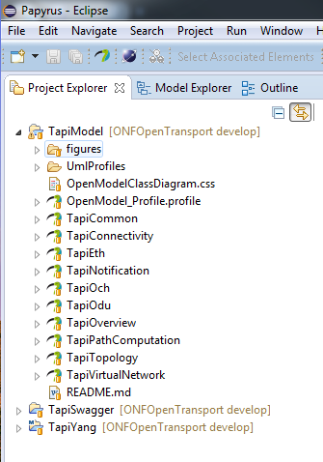
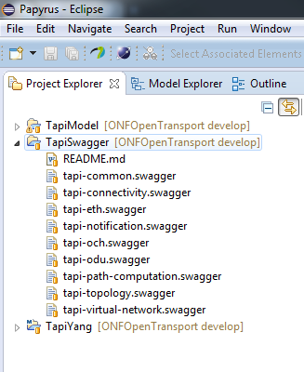
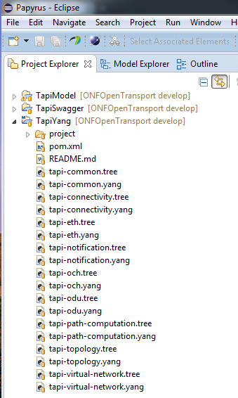
TAPI Projects & Models/Modules

Slide 61







Papyrus UML
YANG IDE
JSON Editor Swagger
Eclipse Modeling Tools
Download Package

Slide 62
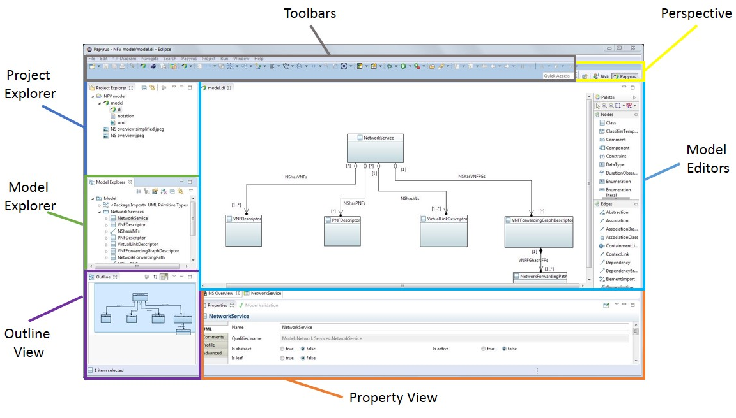
Outline of Papyrus Perspective

Slide 63
Constructing TAPI Modeling Environment

Slide 64

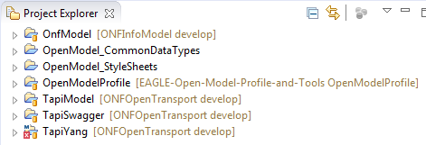
TAPI Resource Dependencies
OpenModel_CoreModel Repository
OpenModel_CommonDataTypes Repository*
OpenModel_StyleSheets Repository*
OpenModel_Profile Repository
TAPI Repository
* not yet created
cloned

Slide 65

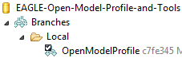
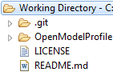
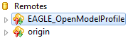
GIT Workflow
remote on GitHub
local on my PC
My Remote Repository
Local Repository
Local Working Directory
2
clone
OpenModel Profile
7
push
3
checkout branch
Staging
EAGLE Open Source Remote Repository
6
merge
1
fork
create remote
0
4
OpenModel Profile
5
fetch remote
administrator
user
automatically

Slide 66
YANG
YANG has... A reasonable self-contained specification
A focus on readers and reviewers
Text-based
Email, patch, and RFC friendly
Limited Scope, but extensible
Ability to model config data, state data, RPCs, and notifications
Experience gained by existing implementations
Design is based on four proprietary modeling languages
Support for YANG
Running code (multiple implementations)
People outside the YANG team using it in other WGs in the IETF
Backing of several NETCONF implementers
Growing group of fans and admirers

Slide 67
Easy to read, easy to learn
container system {
leaf host-name {
type inet:host;
description "Name of this host";
}
container services {
container ssh {
presence "Enables SSH";
description "SSH service specific configuration";
// more leafs, containers and stuff here...
}
}
}
<system>
<host-name>fred</host-name>
<services>
<ssh/>
</services>
</system>

Slide 68
YANG module contents

Slide 69
RESTCONF
RESTCONF
Almost RFC
RESTful protocol to access YANG defined data
Representational State Transfer, i.e. server maintains no session state
URIs reflect data hierarchy in a Netconf datastore
HTTP as transport
Data encaded with either XML or JSON
Operations :

Slide 70
RESTCONF HTTP tree
RESTCONF is a REST-like protocol that provides a HTTP-based API to access the data, modeled by YANG. The REST-like operations are used to access the hierarchical data within a datastore. The information modeled in YANG is structured in the following tree:
/restconf/data : “Data (configuration/operational) accessible from the client but not editable”
/restconf/modules : “Set of YANG models supported by the RESTCONF server”
/restconf/operations : “Set of operations (YANG-defined RPCs) supported by the server”
/restconf/streams: “Set of notifications supported by the server”

Slide 71
YANG Mapping to JSON
JSON is a popular compact and easy to parse data format used by many REST APIs
Subset of YANG compatible XML documents can be translated to JSON text
Translation driven by YANG data model (must be known in advance)
YANG datatype information is used to translate leaf values to the most appropriate JSON representation
Slightly more compact (irrelevant with compression)
Increased human readability (less noise)

Slide 72
YANG mapping to JSON vs XML

Slide 73
Project EAGLE Uml2Yang
Objective
Translates a UML (Unified Modeling Language) model to a YANG model defined in RFC6020
Scope
Work with swagger tool to generate RESTful/RESTconf APIs
Fed to controllers, Apps for interface generation
UML to YANG Mapping Gdls
UML Model
YANG Model
ONF TR-514
IETF RFC 6020

Slide 74



UML to YANG Tool
UML model
Object
Classes
owned
Attributes
Associations
OpenModelProfile
YANG Tool
module
node
leaf
leaf-list
type
rpc
YANG model

Slide 75
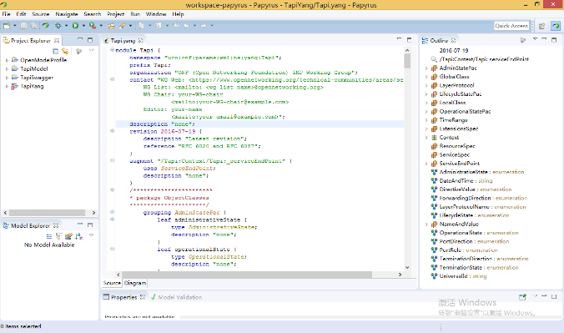
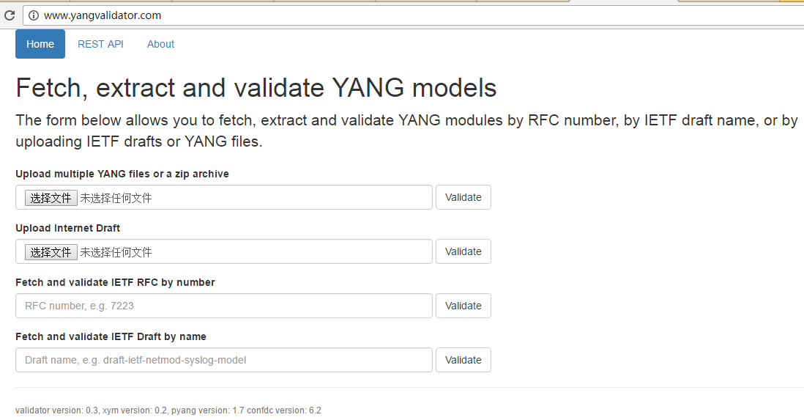
Validate/View YANG files
Eclipse xored IDE: RFC 6020 validation, GUI view
pyang: RFC 6020/6087 validation, command line
YANG validator: RFC 6020/6087 validation, online tool

Slide 76
T-API Swagger specifications
The T-API Swagger specifications provide a mapping from the Yang data schema into JSON Swagger, which can then be used to generate Python and Java code for implementation of the API in RestConf.

Slide 77
YANG data models
YANG is a modeling language designed to create data models for the NETCONF protocol and more recently to RESTCONF. YANG is capable to define configuration and operational state data, remote procedure calls (RPCs) and Notifications.
YANG includes description of:
Config
State
RPCs
Notifications

Slide 78
RESTconf
RESTCONF is a REST-like protocol that provides a HTTP-based API to access the data, modeled by YANG. The REST-like operations are used to access the hierarchical data within a data store. The information modeled in YANG is structured in the following tree:
/restconf/config : “Data (configuration/operational) accessible from the client but not editable”
/restconf/modules : “Set of YANG models supported by the RESTCONF server”
/restconf/operations : “Set of operations (YANG-defined RPCs) supported by the server”
/restconf/streams: “Set of notifications supported by the server”. They are implemented in a websocket
With YANGs + RESTconf ➔
We have the complete Transport REST NBI

Slide 79
T-API Swagger: Documentation
Swagger is a project used to describe and document RESTful APIs.
Swagger 2.0 specification:
http://swagger.io/specification/

Slide 80
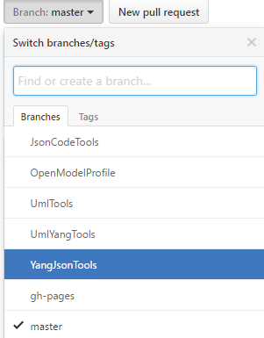
T-API Swagger: From YANG to Swagger Specs
Project Eagle YangJsonTools
https://github.com/OpenNetworkingFoundation/EAGLE-Open-Model-Profile-and-Tools/tree/YangJsonTools
Includes a plugin for Pyang
https://github.com/mbj4668/pyang
Pyang is a YANG validator, transformator and code generator, written in python. It can be used to validate YANG modules for correctness, to transform YANG modules into other formats, and to generate code from the modules.
The project EAGLE YangJsonTools plugin processes the YANG files and describes the associated RESTconf interface using Swagger REST definitions.

Slide 81
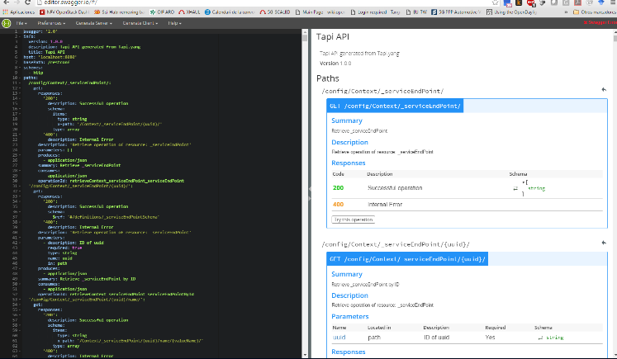
T-API Swagger: Editing Swagger Specs
Using Eclipse JSON editor
Described in T-API Developer Guide
Using Swagger on-line editor
http://editor.swagger.io/

Slide 82
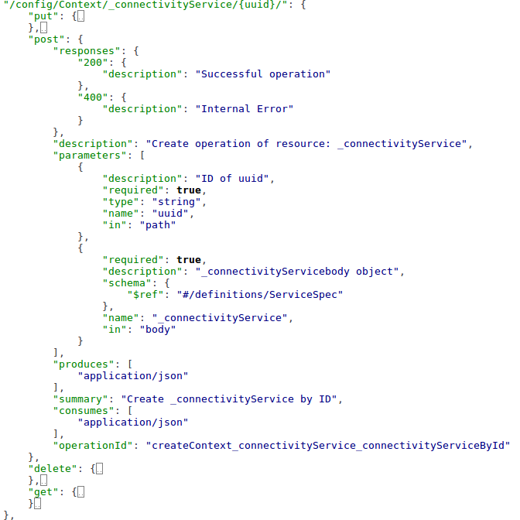
T-API Swagger: Understanding Swagger specs
Paths
Each path may include CRUD (POST, GET, PUT, DELETE) if config
Only GET is allow for State data
Each CRUD includes the following details:
Summary
Parameters (in path or in body)
Responses
Produces/consumes

Slide 83
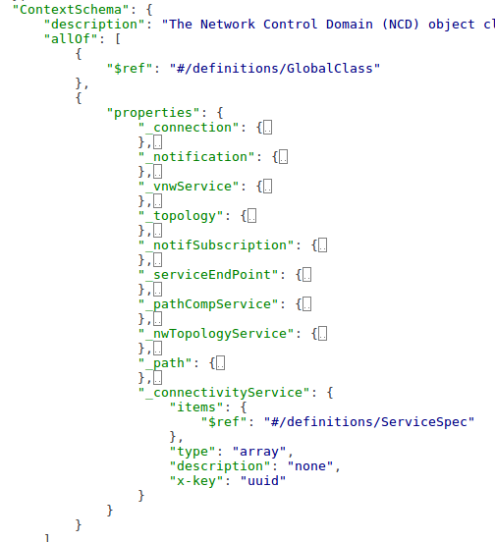
T-API Swagger: Understanding Swagger specs
Definitions
They allow inheritance (allOf)
Items are described in properties
Other descriptions might be referenced (e.g., connectivityService)

Slide 84



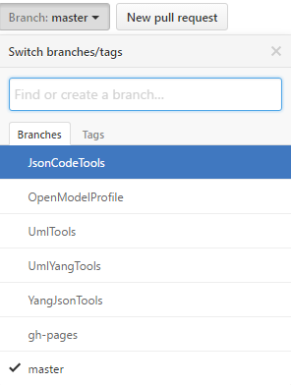
Creating a T-API Reference Implementation
Project EAGLE JsonCodeTools
https://github.com/OpenNetworkingFoundation/EAGLE-Open-Model-Profile-and-Tools/tree/JsonCodeTools
Server Generator for Python
Python code that uses Swagger json outputs from YangJsonTools to generate a RESTful and websocket server and the defined swagger objects, paths and notifications.
SWAGGER files
Project EAGLE JsonCodeTools
T-API Reference Implementation

Slide 85
TAPI Reference Implementation

Slide 86
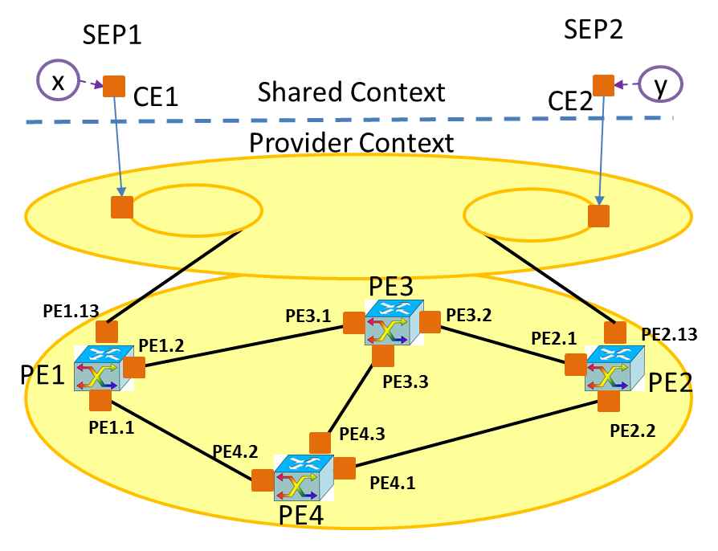
T-API RI: Reference Network
Described in: https://github.com/OpenNetworkingFoundation/Snowmass-ONFOpenTransport/blob/develop/TAPI_RI/server_backend_state.json

Slide 87
T-API RI: Status load
In order to load this scenario in T-API RI, please use the following REST call:
curl -X POST -H "Content-Type: application/json" http://127.0.0.1:8080/backend/load_state/
Response: 200 Loaded State

Slide 88
T-API RI: Basic commands I
GET topologies
curl -X GET -H "Content-Type: application/json" http://127.0.0.1:8080/restconf/config/Context/_topology/
Response:
{
"itemlist": [
"http://127.0.0.1:8080/restconf/config/Context/_topology/top0"
]
}

Slide 89
T-API RI: Basic commands II
GET topology top0
curl -X GET -H "Content-Type: application/json" http://127.0.0.1:8080/restconf/config/Context/_topology/top0/
Response:
{
“_node” : [ … ],
“_link” : [ …],
“uuid” : “top0”
}

Slide 90
T-API RI: Basic commands III
GET ServiceEndPoints
curl -X GET -H "Content-Type: application/json" http://127.0.0.1:8080/restconf/config/Context/_serviceEndPoint/
Response:
{
"itemlist": [
"http://127.0.0.1:8080/restconf/config/Context/_serviceEndPoint/se1",
"http://127.0.0.1:8080/restconf/config/Context/_serviceEndPoint/se2"
]
}

Slide 91
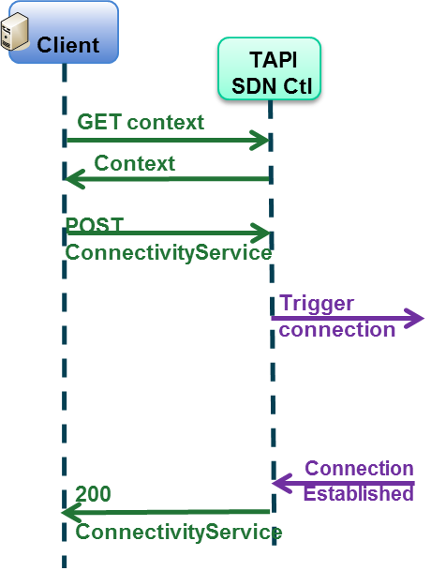
T-API RI: Connectivity Service workflow

Slide 92
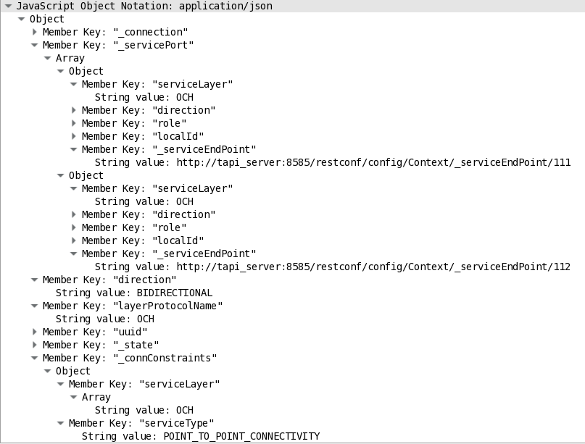
T-API RI: Establish Connectivity Service
curl -X POST -H "Content-Type: application/json" http://127.0.0.1:8080/restconf/config/Context/_connectivityService/cs1/ -d‘
{"uuid":"cs1",
"_connConstraint":{
"serviceType":"POINT_TO_POINT_CONNECTIVITY", "serviceLayer":["OCH"] }, "_servicePort":[
{ "localId":"sp1", “serviceLayer":"OCH" , "direction":"BIDIRECTIONAL", "role":"SYMMETRIC", "_serviceEndPoint":http://127.0.0.1:8080/restconf/config/Context/_serviceEndPoint/se1
},
{ "localId":"sp2", "serviceLayer":"OCH" , "direction":"BIDIRECTIONAL", "role":"SYMMETRIC", "_serviceEndPoint":http://127.0.0.1:8080/restconf/config/Context/_serviceEndPoint/se2
} ]
}'

Slide 93
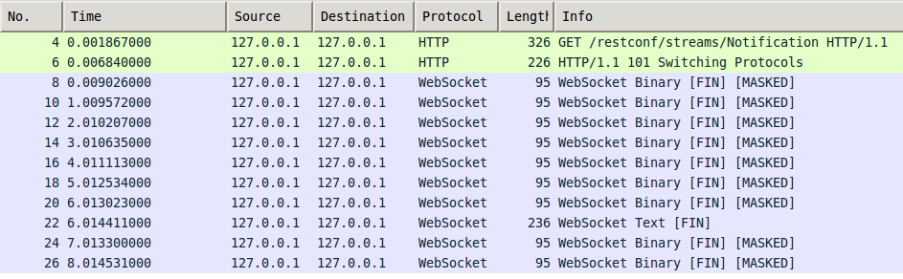
T-API RI: Notifications
Notifications will be provided with Websockets. T-API reference implementation provides an example of a client accessing the websocket:
http://localhost:8182/restconf/streams/NotificationService

Slide 94
T-API App
Objective:
Retrieve Network Topology using T-API
Steps:
Run TAPI-RI
Load topological information:
curl -X POST -H "Content-Type: application/json" http://127.0.0.1:8080/backend/load_state/
Start coding using the following libraries:
NetworkX
Requests
Json

Slide 95
ODL/ONOS northbound REST API

Slide 96
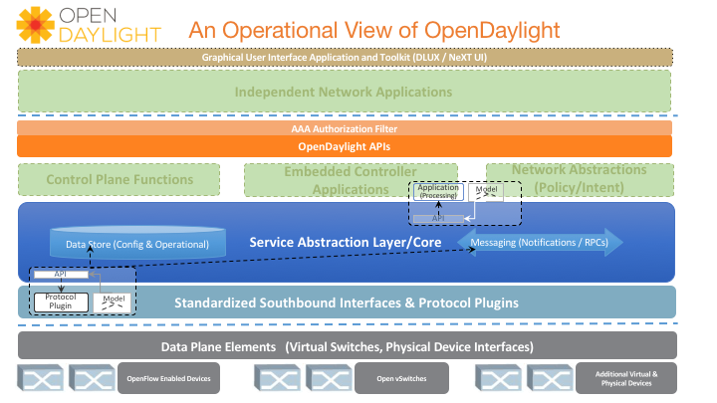
OpenDayLight NBI

Slide 97
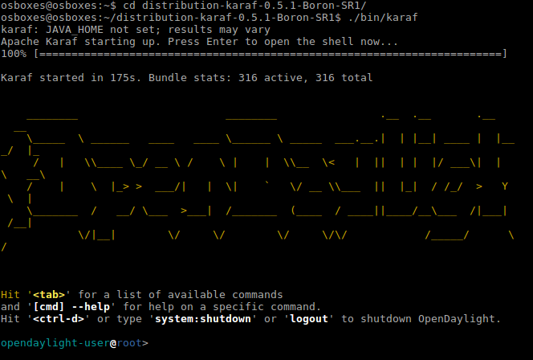
OpenDayLight NBI

Slide 98
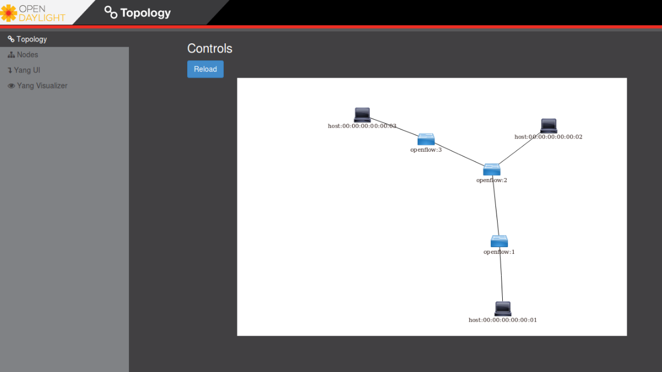
OpenDayLight NBI
sudo mn --topo linear,3 --mac --controller=remote,ip=127.0.0.1,port=6633 --switch ovs,protocols=OpenFlow13

Slide 99
Setup ODL
curl -X PUT -H"Content-Type: application/json" -u admin:admin http://localhost:8181/restconf/config/l2switch-config:l2switch-config -d'{"l2switch-config": {"is-learning-only-mode": "true","is-install-dropall-flow": "true"}}‘
curl -X PUT -H"Content-Type: application/json" http://localhost:8181/restconf/config/arp-handler-config:arp-handler-config -u admin:admin -d'{"arp-handler-config": {"is-proactive-flood-mode": "false"}}‘

Slide 100
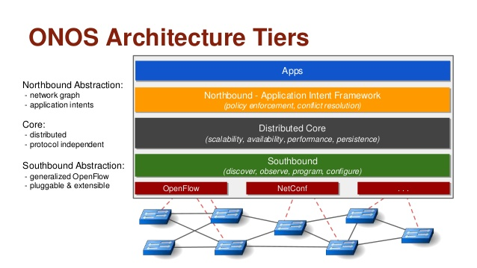
ONOS architecture

Slide 101
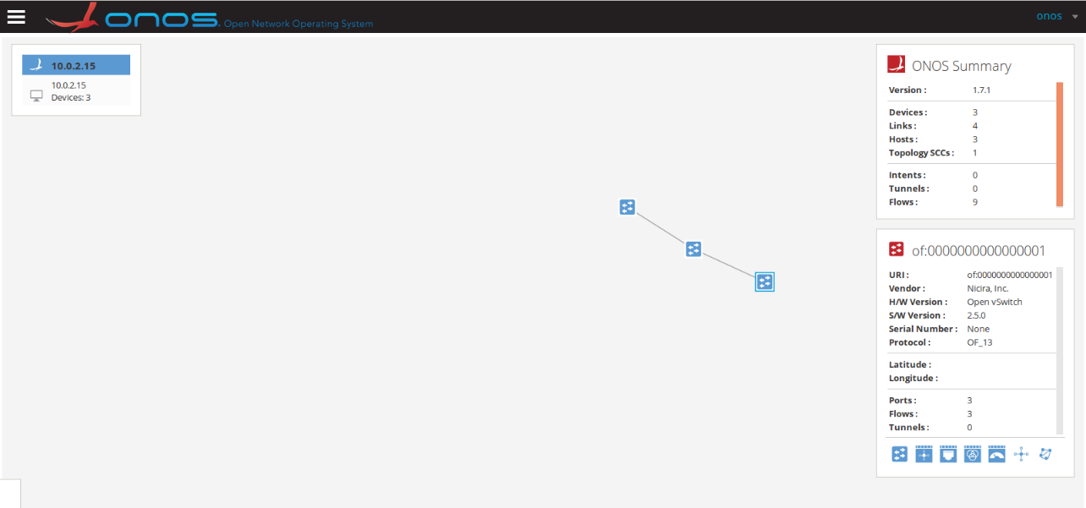
ONOS NBI
~/onos-1.7.1/apache-karaf-3.0.5/bin$ ./karaf
app activate org.onosproject.openflow

Slide 102
Integrating with TAPI_RI
Topology
funcs_TapiTopology/context_TopologyUuidImpl.py
Connectivity
funcs_TapiConnectivity/context_ConnectivityserviceImpl.py

Slide 103
Conclusion

Slide 104
TAPI Next Steps – 2.0
ONF Transport API 2.0 focus items
Node Configuration – functional aspects
Includes Port/NodeEdgePoint configuration
Termination functions, etc
Forwarding, Processing
Protection
Multi-layer, Multi-Domain
Based on focus use cases under discussion
OAM/Monitoring
Consistent Multi-layer abstraction and model – L0-L2
Alarms/TCAs/Counters
Multi-Point, Multi-Layer, Multi-Domain use case enhancements
Virtual Transport Network enhancements
Multi-Technology
Microwave
Ethernet

Slide 105
Standards vs Open Source

Slide 106
Transport SDN Benefits and Challenges

Slide 107
References
ONF SDN Architecture 1.1 - https://www.opennetworking.org/images/stories/downloads/sdn-resources/technical-reports/TR-521_SDN_Architecture_issue_1.1.pdf
TAPI Functional Requirements 1.0 - https://www.opennetworking.org/images/stories/downloads/sdn-resources/technical-reports/TR-527_TAPI_Functional_Requirements.pdf
TAPI SDK (SNOWMASS) - https://github.com/OpenNetworkingFoundation/Snowmass-ONFOpenTransport
UML Tools (EAGLE) - https://github.com/OpenNetworkingFoundation/EAGLE-Open-Model-Profile-and-Tools
TAPI 1.0 SDK Overview ONF MWD, Sept 7, 2016 https://github.com/OpenNetworkingFoundation/Snowmass-ONFOpenTransport/raw/develop/DOCS/presentations/onf2016.307_TAPI_SDK.01.pptx
OFC 2017: OIF Interop – The Key to Unlocking the Benefits of SDN, Tuesday, 21 March; 15:00 - 16:00.
OFC 2017: ONF Session – The path Forward, Thursday, 23 March, 12:00 - 13:30
Victor Lopez, et al., Transport API: A Solution for SDN in Carriers Networks, ECOC 2016; 42nd European Conference on Optical Communication.

Slide 108
Thank you! Questions?
ricard.vilalta@cttc.es
karthik.sethuraman@necam.com

